Slide 1
PROJECT TITLE
Agentic AI on IBM Cloud
Presented By: Chillapalli Harish – PSCMR Engineering College – Department of CSE

Slide 2
OUTLINE
Problem Statement (Should not include solution)
Proposed System/Solution
System Development Approach (Technology Used)
Algorithm & Deployment
Result (Output Image)
Conclusion
Future Scope
References

Slide 3
Problem Statement
With the rapid adoption of AI, businesses require tools that can automate tasks, process documents, and respond to queries efficiently. Traditional AI workflows often lack easy integration, scalability, and quick deployment capabilities. The challenge is to create an AI Agent that can interact with user-provided knowledge, answer domain-specific queries, and be deployed in a scalable cloud environment.

Slide 4
Proposed Solution
Our solution leverages IBM watsonx.ai Studio to create, configure, and deploy a domain-specific AI agent. Key features include:
Document Understanding – AI processes uploaded PDF/Docs to extract knowledge.
Custom Model Selection – Uses Mistral-Large model for better accuracy.
Tool Integration – Enables features like web search or automation.
Cloud Deployment – Makes the AI accessible via APIs in deployment spaces.
Benefits:
Scalable and secure infrastructure with IBM Cloud.
Simple workflow for AI creation without coding barriers.
Cost-effective lite plan for development and testing.

Slide 5
System Approach
Technologies Used:
IBM Cloud (Dashboard, Deployment Spaces)
IBM watsonx.ai Studio
Mistral-Large Foundation Model
Cloud Object Storage (Lite Plan)
Development Steps:
Login & Setup – Access IBM Cloud, open watsonx.ai Studio.
Project Creation – Create sandbox project with cloud storage.
Service Association – Link Watsonx.ai Runtime.
Agent Building – Upload documents, enable tools, set knowledge base.
Deployment – Create deployment space and deploy the agent.
Testing & API Access – Verify outputs and integrate with applications.

Slide 6
Algorithm & Deployment
Algorithm Workflow:
Input Data – Upload PDFs/documents to Watsonx.ai Studio.
Vector Indexing – Convert documents into embeddings for fast retrieval.
Model Selection – Choose Mistral-Large for accurate responses.
Query Processing – Match questions with relevant knowledge chunks.
Tool Execution – Enable tools for extended AI capabilities.
Deployment Steps:
Create a deployment space.
Deploy the AI agent to the cloud.
Generate API endpoints for integration.
Test responses in real-time.

Slide 7
Result
Our deployed AI Agent:
Successfully processed custom documents and answered domain-specific questions.
Provided accurate, context-aware responses using the selected model.
Was deployed to a cloud environment with API access.
Key Outputs:
Custom Knowledge Retrieval – Instant Q&A from uploaded docs.
API Reference – For integration with web or mobile applications.
Deployment Verification – Output screenshots confirming successful execution.

Slide 8
Conclusion
We successfully built an Agentic AI using IBM watsonx.ai Studio.
The system allows domain-specific customization through document uploads.
Deployment on IBM Cloud ensures scalability, accessibility, and security.
This approach can be applied to various industries such as education, healthcare, and customer service.

Slide 9
Future scope
Integration with real-time web data sources for updated knowledge.
Support for multimodal AI (text, images, voice inputs).
AI-powered analytics dashboard for performance monitoring.
Multi-language support for wider user adoption.
Linking with IoT devices for intelligent automation workflows.

Slide 10
References
IBM Cloud: https://cloud.ibm.com
IBM watsonx.ai Studio Documentation
Mistral Model Technical Specs
AI Deployment Best Practices – IBM Research

Slide 11
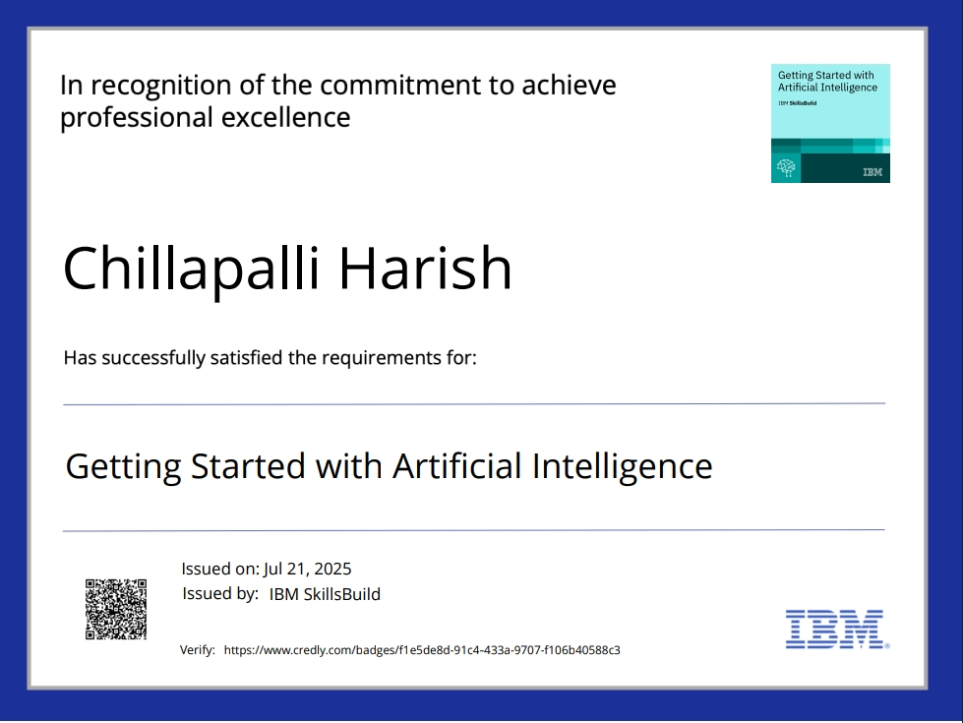
IBM Certifications
Screenshot/ credly certificate( getting started with AI)

Slide 12
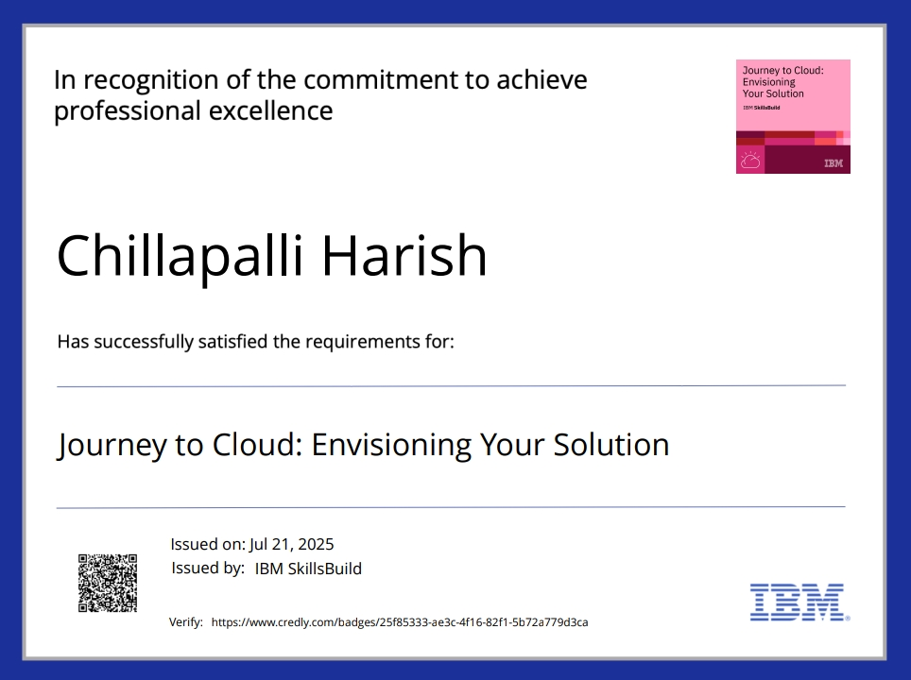
IBM Certifications
Screenshot/ credly certificate( Journey to Cloud)

Slide 13
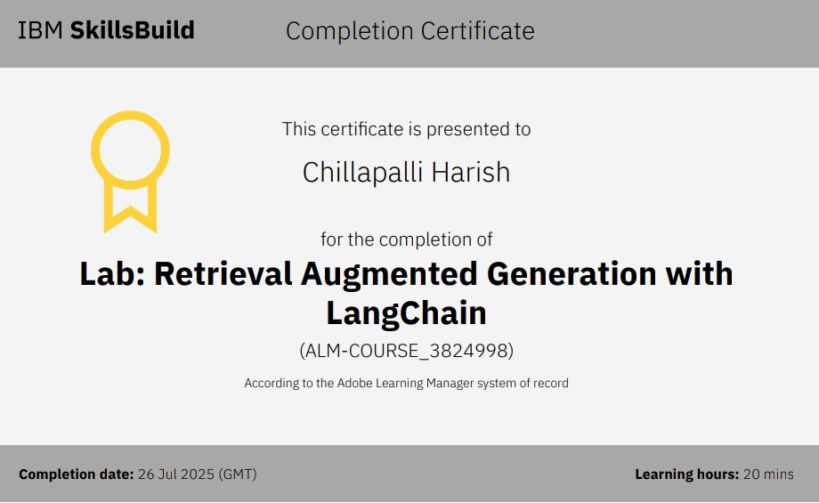
IBM Certifications
Screenshot/ credly certificate( RAG Lab)

Slide 14
THANK YOU

